Slide 1
Residual Learning in Adversarial Domain Adaptation Networks
He, LI
BCMI Lab
Shanghai Jiao Tong University
8th May, 2018
https://github.com/polarskie/TResNet

Slide 2
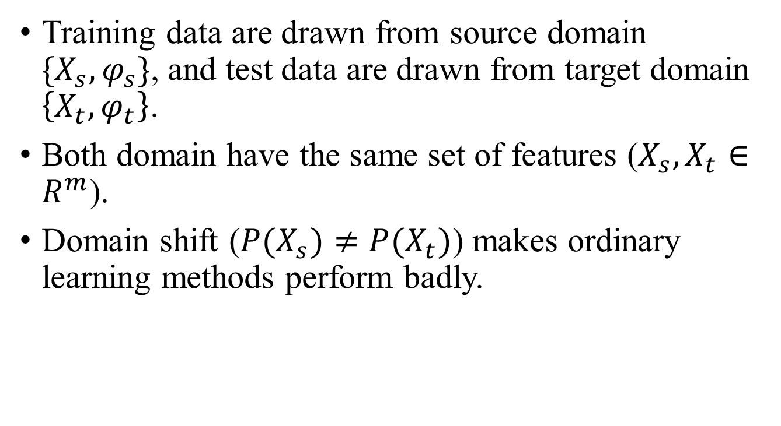
The Domain Adaptation Problem
Training data are drawn from source domain $\{X_{s},φ_{s}\}$, and test data are drawn from target domain $\left\{X_{t},φ_{t}\right\}$.
Both domain have the same set of features ($X_{s},X_{t}∈R^{m}$).
Domain shift ($P(X_{s})≠P(X_{t})$) makes ordinary learning methods perform badly.

Slide 3
Domain Adaptation with Adversarial Networks
Neural networks are used to transform the original feature into a new feature space where:
The new features keep essential information (for label prediction) and optimize the data distribution.
Domain shift is reduced (features from both domains share similar distributions in the new feature space)

Slide 4
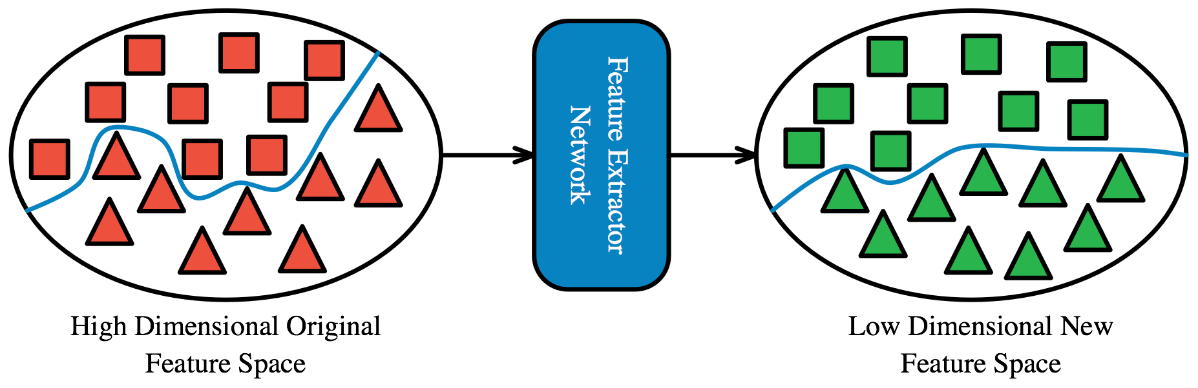
Domain Adaptation with Adversarial Networks
Neural networks are used to transform the original feature into a new feature space where:
The new features keep essential information (for label prediction)
Domain shift is reduced (features from both domains share similar distributions in the new feature space)

Slide 5
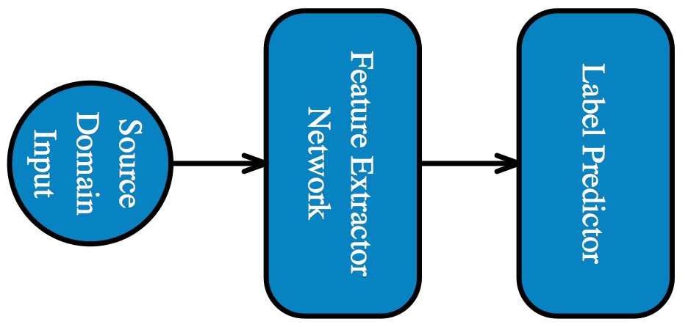
Domain Adaptation with Adversarial Networks
Neural networks are used to transform the original feature into a new feature space where:
The new features keep essential information (for label prediction)
Domain shift is reduced (features from both domains share similar distributions in the new feature space)

Slide 6
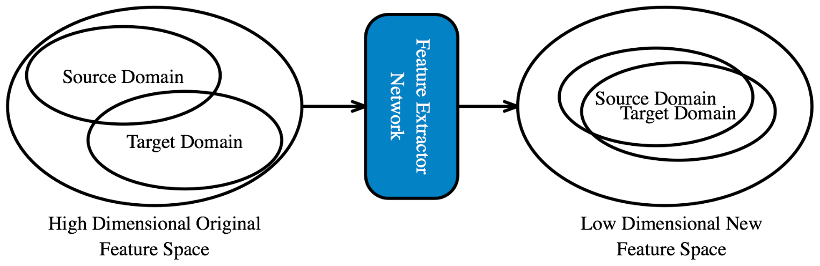
Domain Adaptation with Adversarial Networks
Neural networks are used to transform the original feature into a new feature space where:
The new features keep essential information (for label prediction)
Domain shift is reduced (features from both domains share similar distributions in the new feature space)

Slide 7
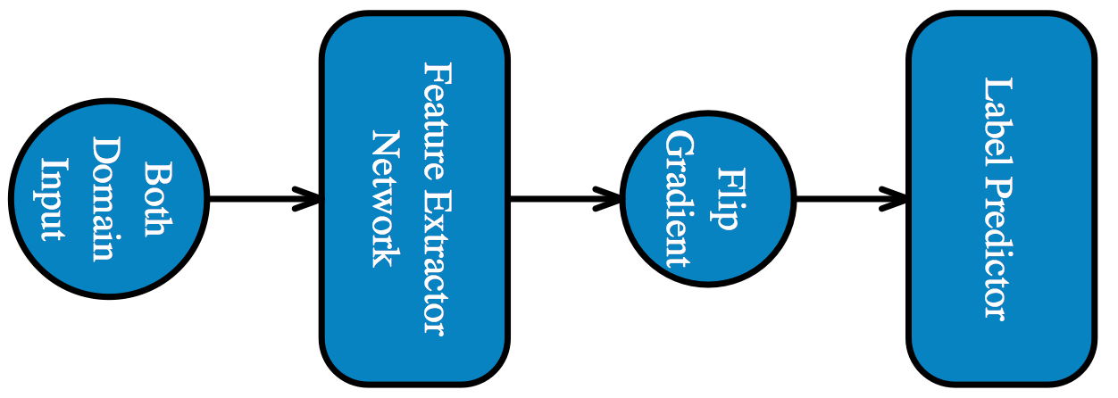
Domain Adaptation with Adversarial Networks
Neural networks are used to transform the original feature into a new feature space where:
The new features keep essential information (for label prediction)
Domain shift is reduced (features from both domains share similar distributions in the new feature space)

Slide 8
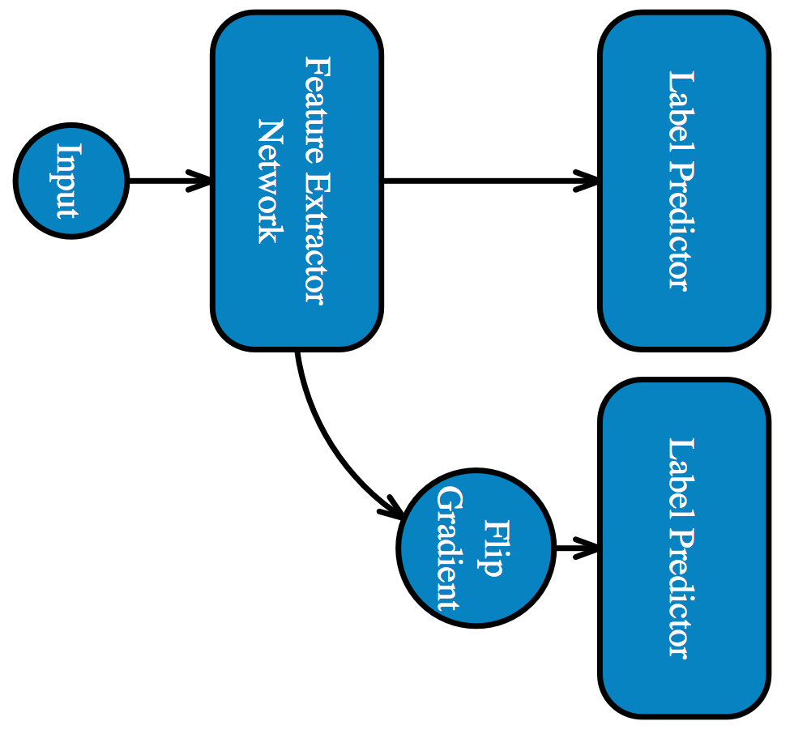
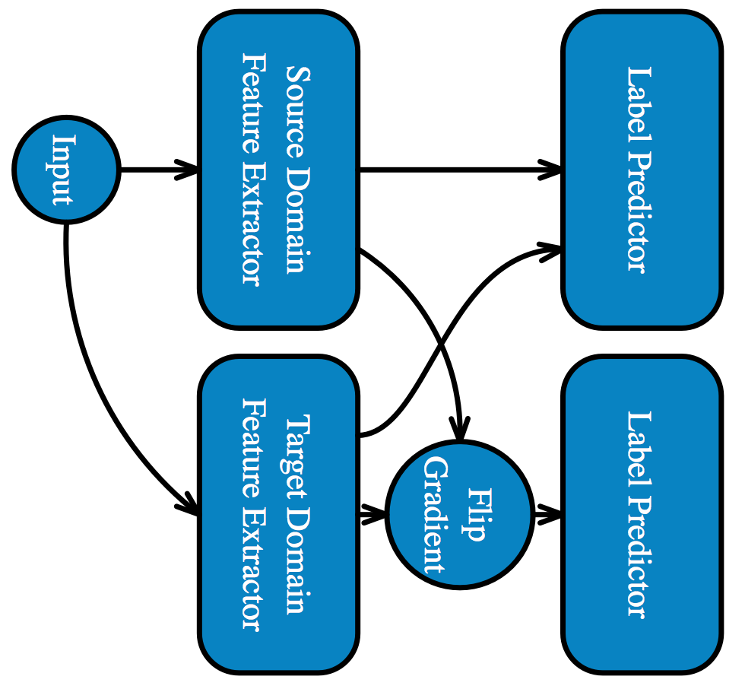
Domain-Adversarial Neural Network and Adversarial Discriminative Domain Adaptation

Slide 9
Limitations
For DANN, when there are many source domains, we doubt whether one feature extractor is enough to eliminate the domain shift between all of them.
For ADDA, multi-source-domain adaptation is not supported by its nature.
For both methods, an unseen new domain involves retraining. Previous training provides little intuition for the new domain feature extractor.

Slide 10
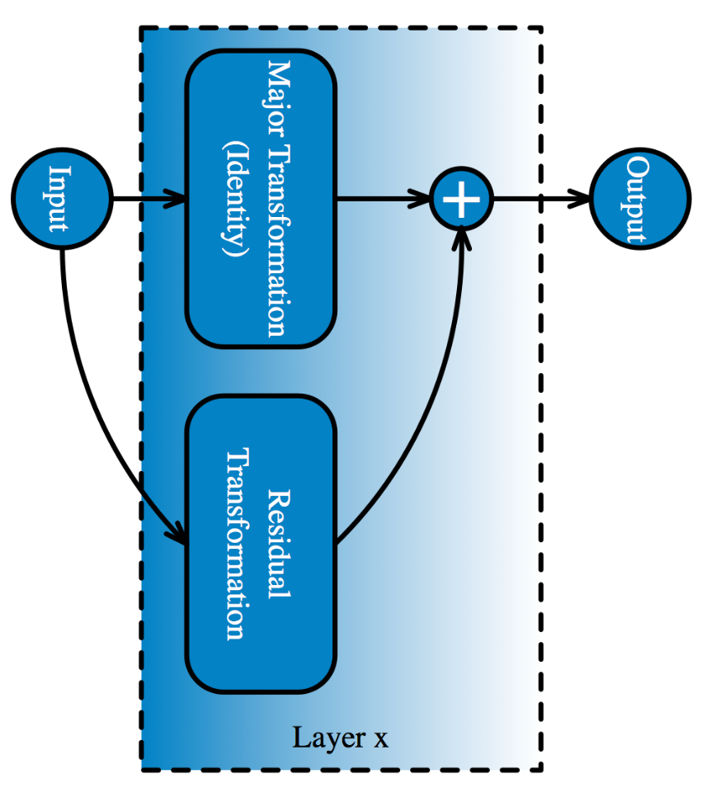
Residual Learning in Neural Networks
For one layer in a neural network
The transformation of the layer is divided into 2 portions: major and residual transformation.
The major transformation can be considered as prior intuition of the whole layer.
The residual transformation is what we optimize during the training procedure.
The residual transformation, as the name indicates, is minor compared with the major one. Thus the parameters have small absolute values, making the network easy to learn.

Slide 11
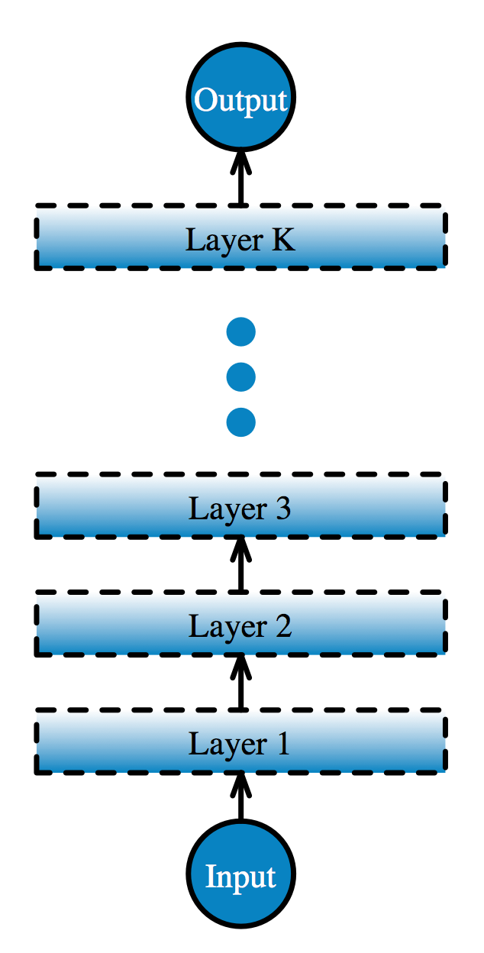
Residual Learning in Neural Networks
For one layer in a neural network
The transformation of the layer is divided into 2 portions: major and residual transformation.
The major transformation can be considered as prior intuition of the whole layer.
The residual transformation is what we optimize during the training procedure.
The residual transformation, as the name indicates, is minor compared with the major one. Thus the parameters have small absolute values, making the network easy to learn.

Slide 12
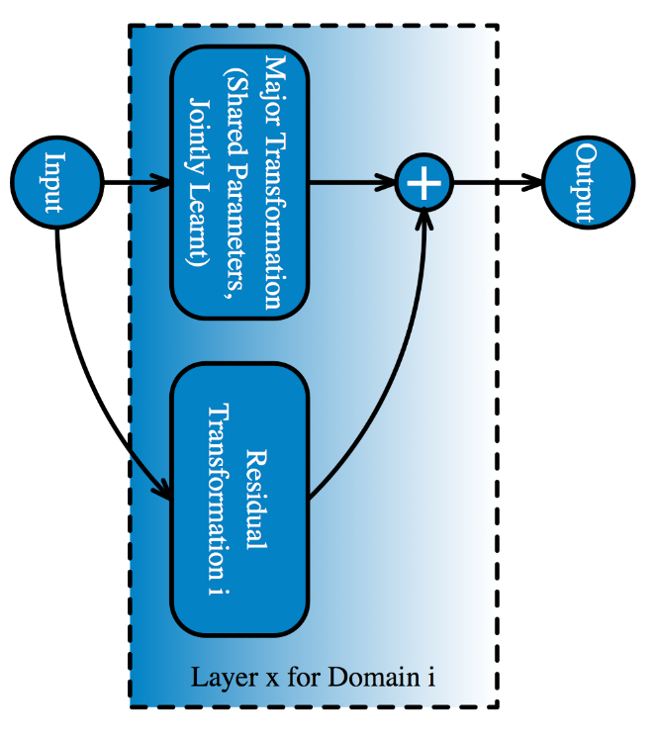
Proposed: Residual Learning for Domain Adaptation
When it comes to neural network based domain adaptation, for one layer:
The major transformation can be defined as the common transformation for all of the domains.
The residual transformation can be defined as the unique transformation specially designed for each domain.

Slide 13

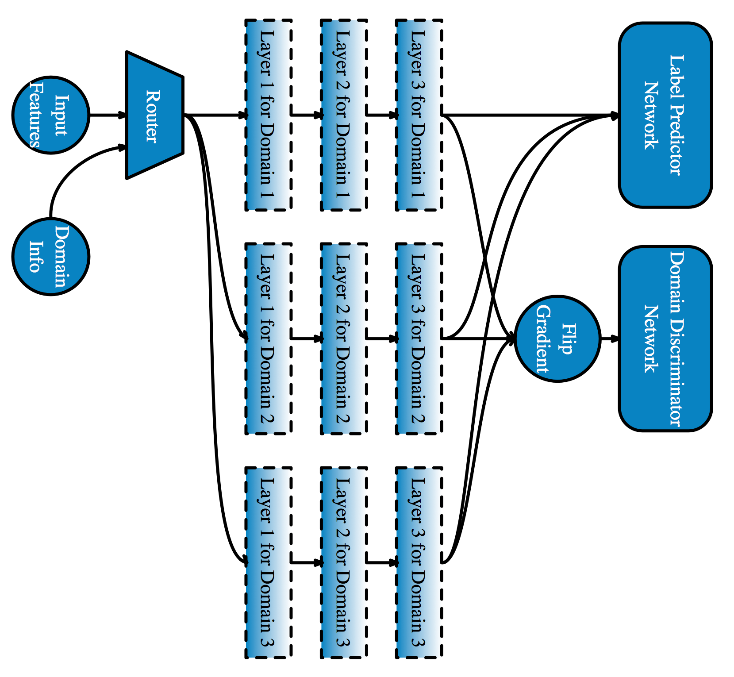
Proposed: Residual Learning for Domain Adaptation

Slide 14
Merits
Extensibility
Support multi-source-domain and multi-target-domain adaptation by its nature.
Benefit from, but not worry about, the number of domains.
For an unseen domain, simply train a set of residual parameters (benefit from the previous training).
Controllability
Use L1 or L2 regularization to control the capacity.
Incorporate prior knowledge to restrict the residual parameters.
Gain layer-wise control.

Slide 15
Challenges
Regularize or not. If yes, what kind of? Maybe that is task dependent.
Trade off between the label prediction loss and the domain discrimination loss.
Experiments.

